Slide 1

Object Oriented Programming HTML5 Tutorials Tutorial #5 : Using keyboard to control a game object
Department of Computer Science and Information Engineering
Shuo-Han Chen (陳碩漢), shchen@csie.ntut.edu.tw
Hong-Yue Technology Research Building 1223
F 09:10 - 12:00
Notes:
Good Afternoon everyone
I am Shuo-Han Chen, a postdoctoral research fellow at Academia Sinica
It is a great honor to be invited by the department for being here today

Slide 2

HTML5 Game Framework 使用說明
Tutorial 5: 鍵盤事件
Notes:
Thank you for listening. Now, I would like to end today’s talk by the Q & A time.

Slide 3
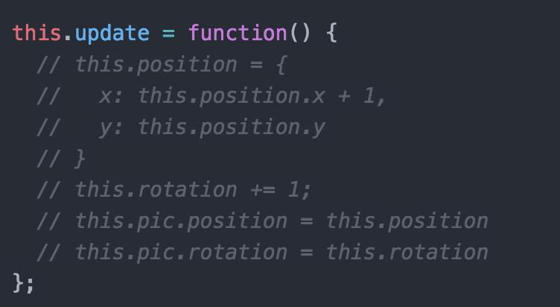
1.接續 Tutorial3 的 Practice物件 , 希望修改為由鍵盤事件控制 , 因此先註解Practice.js update function自動改變的部分

Slide 4
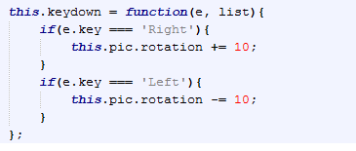
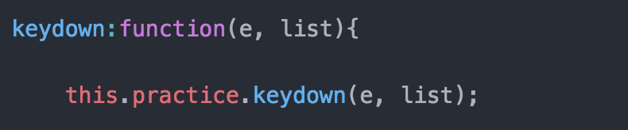
2.在 Practice.js 中加入 keydown function為鍵盤操作事件觸發
3.在 myGameLevel1.js 的 keydown function 中，增加practice.keydown()

Slide 5
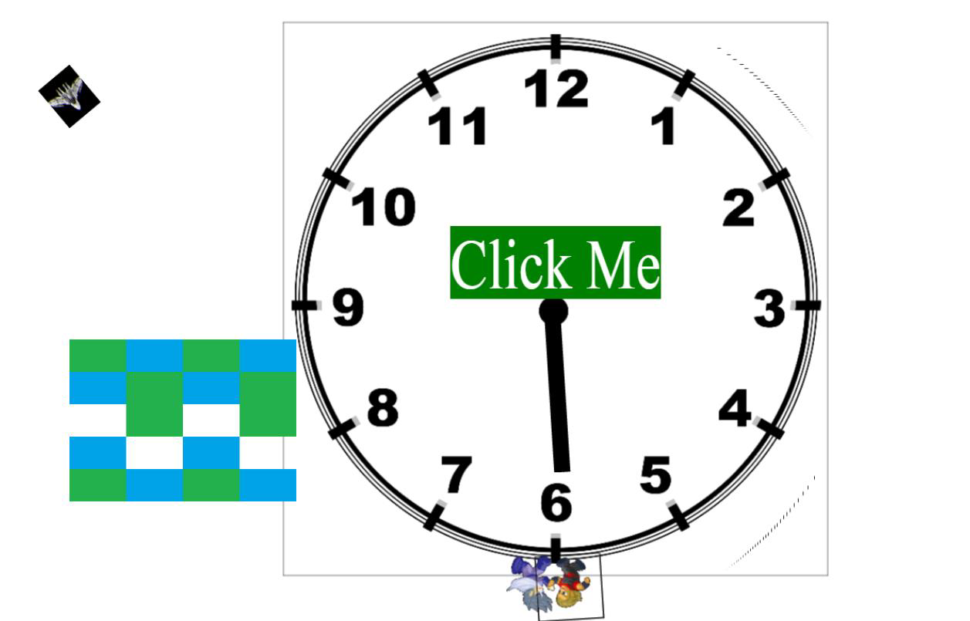
4.執行結果(按左 ,右方向鍵 )

